Slide 1

Combining and Interpreting Data in Microbiome Studies
Davit Sargsyan
Dr. Kong’s Lab
Rutgers School of Pharmacy Seminar
Spring 20201

Slide 2
Agenda
Introduction
Effect of PEITC diet on Nrf2 KO vs. WT Mice
PEITC and Cranberry diet in DSS-treated WT and Nrf KO Mice
Q&A
1
2
3
4

Slide 3
1. Introduction

Slide 4
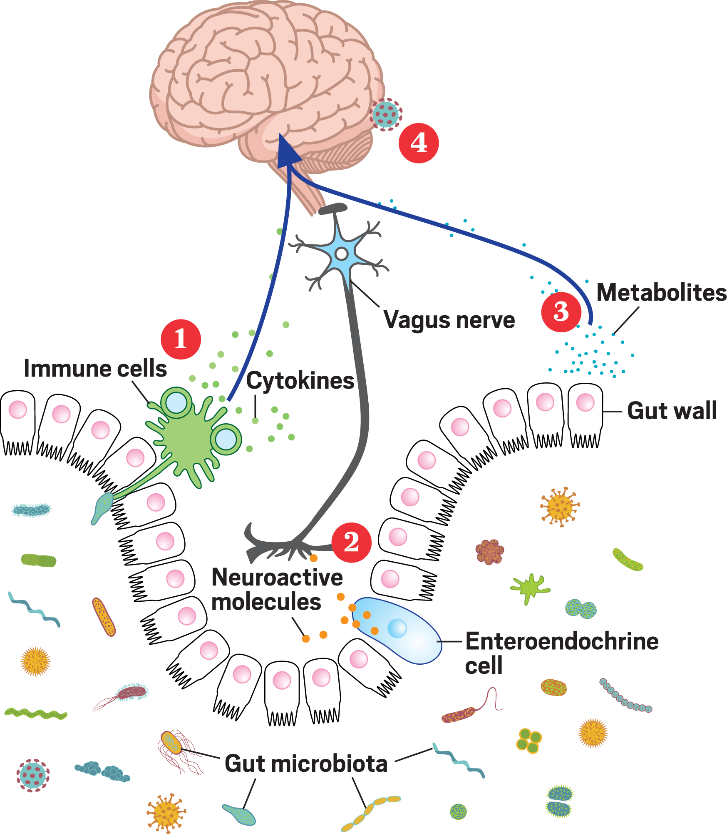
What is microbiome?
Gastrointestinal (GI) tract is populated with a large number of bacterial species
Bacteria helps process food, and produces metabolites that interact with the host’s GI cells
Shown to affect GI immune cells but can have an impact beyond GI
https://cen.acs.org/biological-chemistry/microbiome/gut-might-modify-mind/97/i14

Slide 5
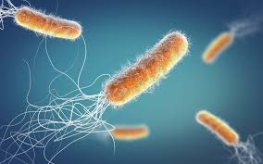
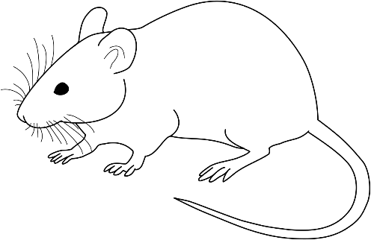
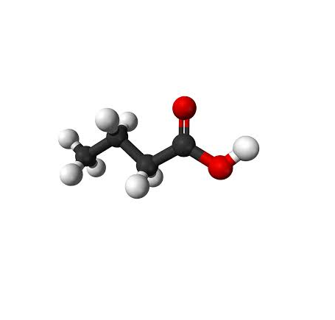
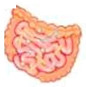
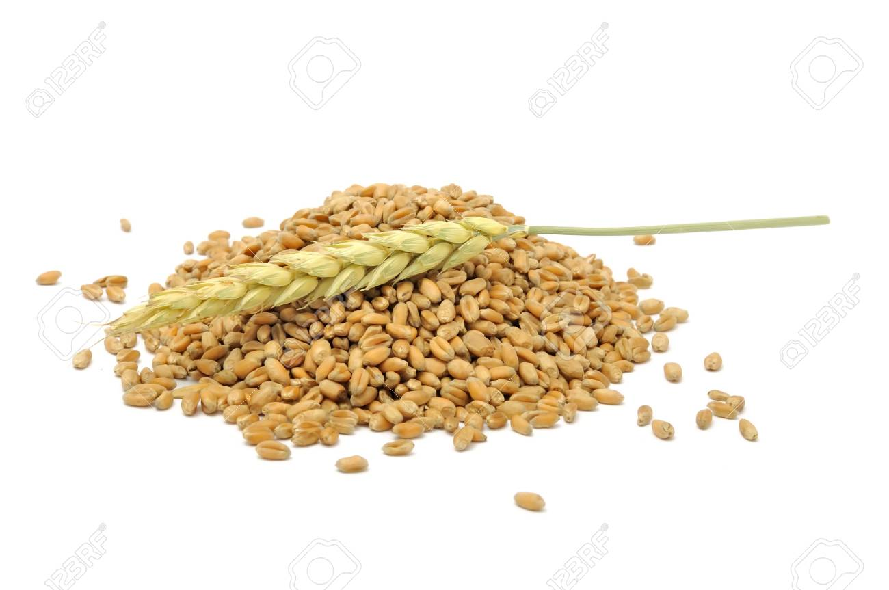
In Vivo Models to Study Microbiome
Mouse guts are populated with native bacterial community (high variability) or an implanted one.
Can use fecal transplant, probiotic cocktail, etc.
For best results implant into germ-free mouse (may require germ-free facility) or antibiotic/high-fiber pretreated mouse. This stabilizes baseline.
Depending on the bacterial composition, genotype, treatment and diet, the microbiome will be expected to produce certain bacterial metabolites that can interact with the host’s cells.

Slide 6
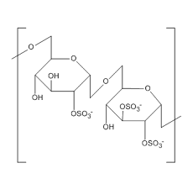
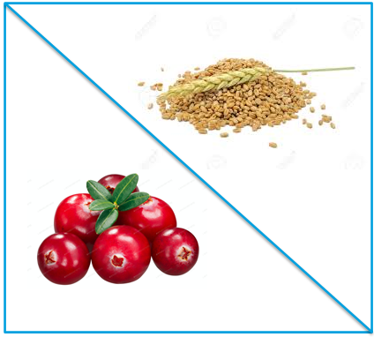
Diet Effect in DSS-Induced IBD Model
Dextran sodium sulfate (DSS) is commonly used in inflammatory bowel disease (IBD) models. Alternatively, lipopolysaccharide (LPS) can be used to induce inflammation.
The animal is then treated with an anti-inflammatory compound or a special diet that contains anti-inflammatory chemicals.
Some foods (e.g. cranberries) contain chemicals that can be processed by gut bacteria and produce anti-inflammatory metabolites (short-chain fatty acids (SCFA), n-butyrate, etc., see this reference, for example) that can activate host’s Treg cells.

Slide 7
Aside: Bacterial Communities Can be Used as Treatment
Several drug development programs considered using specific bacterial cocktails as the treatment to restore homeostasis in guts.
Vedanta Biosciences collaborated with Janssen R&D on VE202 cocktail development (mixture of 11 or more bacterial strains isolated from a healthy subject, based on work by Atarashi et al).
If successful, it can repopulate guts of patients suffering from ulcerative colitis and Crohn’s disease with beneficial bacteria and reduce/eliminate inflammation.

Slide 8
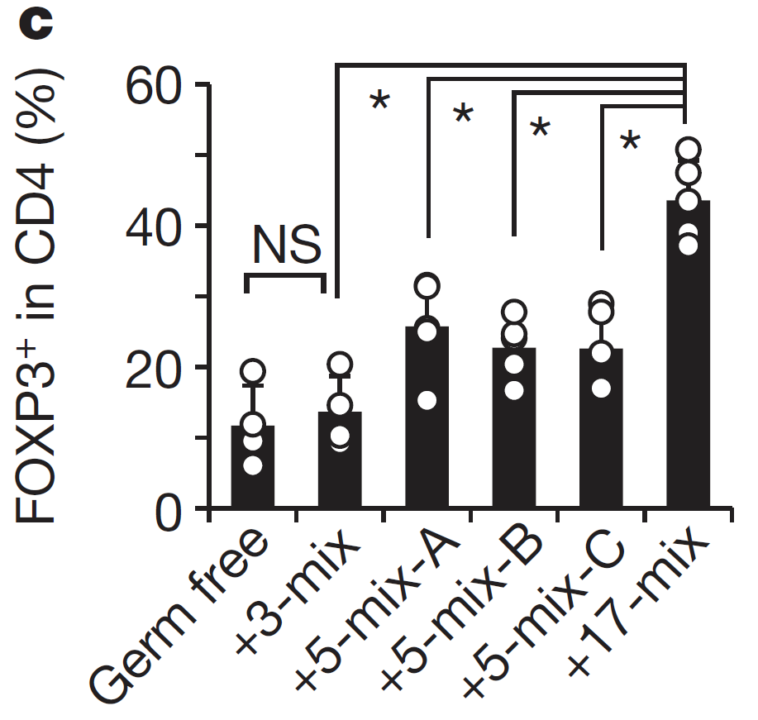
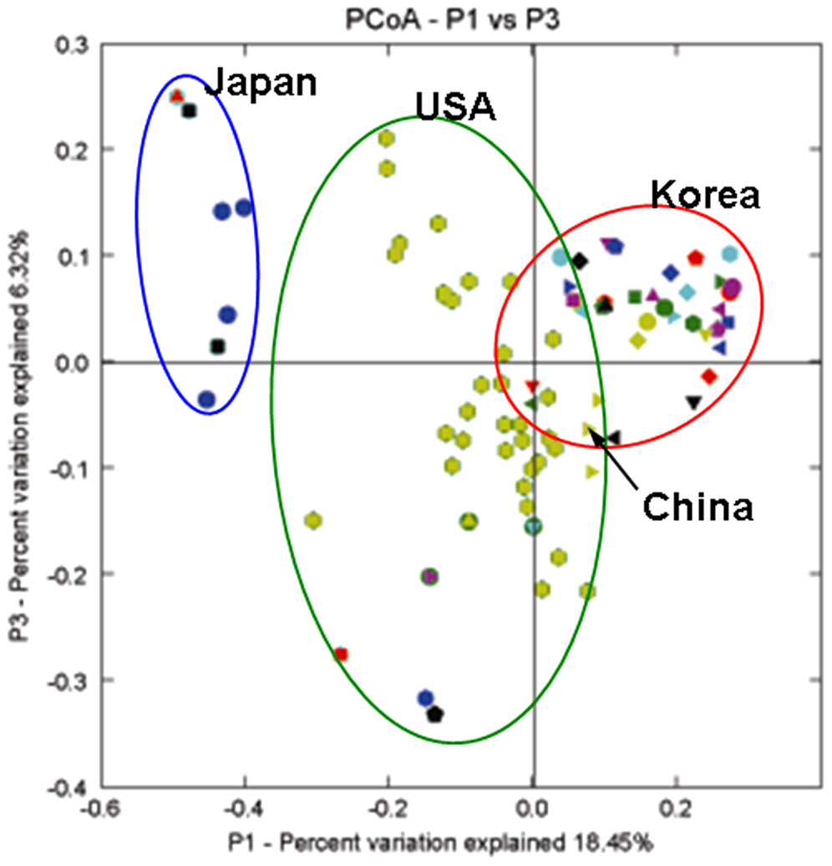
Aside: Bacterial Communities Can be Used as Treatment
Regional and cultural differences of patients: culinary preferences and ingredients, exposure to the environment, genetics, …)
Percentages of FOXP31 cells within the CD41 cell population in IQI exGF mice colonized with the indicated mix (Atarashi 2013)
Challenges for developing such bacterial treatment:
High cost of R&D and manufacturing
Intellectual property protection (what is being patented – the mixture, the formulation, delivery system to avoid destruction in stomach, …)
Comparison of Korean gut microbial communities to that of non-Korean people (Nam 2011)

Slide 9





Aside: Research Collaborations on VE202
Luc Bijnens
Dea Putri
ThierryVan Effelterre
Kathy Mutambanengwe
Matilda Hshieh
Ziv Shkedy
Nolen Joy Perualia
Rudradev** Sengupta
Martin Blaser*
Victoria Ruiz
Thomas Battaglia
Jeremiah Faith
Eduardo Contijoch
Graham
Olivier Thas
Stijn Hawinkel
(*)Dr. Blaser is currently the director of the Center for Advanced Biotechnology and Medicine at Rutgers Biomedical and Health Sciences
(**) Dr. Sengupta is currently at Janssen PRD

Slide 10
Microbiome Studies at Dr. Kong’s Lab
Dr. Kong’s Lab (Ran Yin, Rasika Hudlikar, Renyi Wu, et al) conducted a series of in vivo experiments to understand compositional differences and changes in microbial communities based host’s genotype, inflammation model and diet.
Here we will present the results from the first 3 studies with more work ongoing.
In addition to microbial counts, bacterial metabolites’ abundance was recorded in the last study.
We attempt to reconcile these 2 types of data using advanced statistical modeling and visualization techniques.

Slide 11
2. Effect of PEITC diet on Nrf2 KO vs. WT Mice

Slide 12
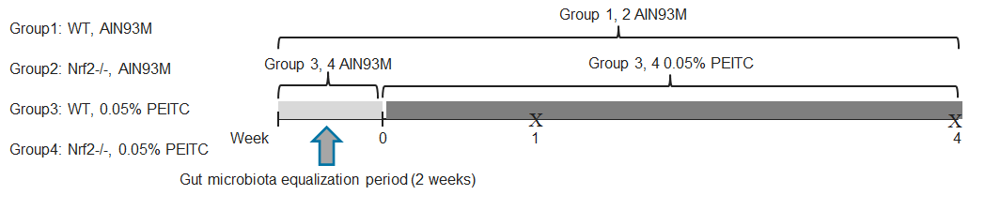
Nrf2 KO PEITC Study Design
C57BL/6J wild-type (WT) mice were purchased from Jackson Laboratory
C57BL/6J Nrf KO mice colony have been maintained in our laboratory since 2005
Mice were firstly given a 2-week gut microbiota equalization period fed with AIN-93M control diet (Research Diets, Inc. NJ)

Slide 13
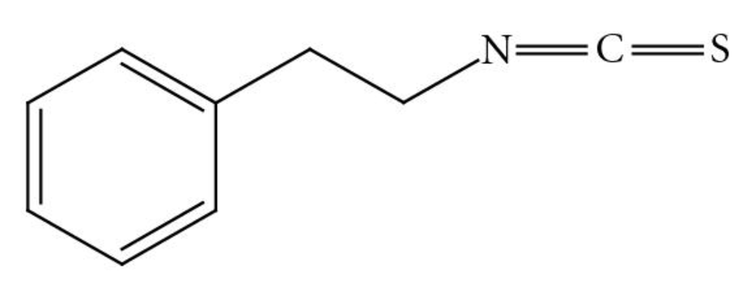
Nrf2 KO PEITC Study Design
Two separate studies were conducted:
Nrf KO (November 2018): 2 diets, 5 animals per group
WT (May 2019): 2 diets, 9 animals per group
After the 2-week period, mice in each study and each genotype were randomized to one of 2 diets:
Control (stayed on AIN-93M diet) or
PEITC (AIN-93M + 0.05% PEITC) diet.
Phenethyl isothiocyanate (PEITC) can be isolated from cruciferous vegetables, cranberries, etc. and can block chemical carcinogenesis in animal models.
Class description | Ingredients | Grams
Protein | Casein, Lactic, 30 Mesh | 140.00 g
Protein | Cystine, L | 1.80 g
Carbohydrate | Starch, Corn | 495.69 g
Carbohydrate | Lodex 10 | 125.00 g
Carbohydrate | Sucrose, Fine Granulated | 100.00 g
Fiber | Solka Floc, FCC200 | 50.00 g
Fat | Soybean Oil, USP | 40.00 g
Mineral | S10022M | 35.00 g
Vitamin | V10037 | 10.00 g
Vitamin | Choline Bitartrate | 2.50 g
Anti-oxidant | tert-Butylhydroquinone (tBHQ) | 0.01 g
 | Total: | 1000.00 g
Phenethyl isothiocyanate (PEITC)

Slide 14
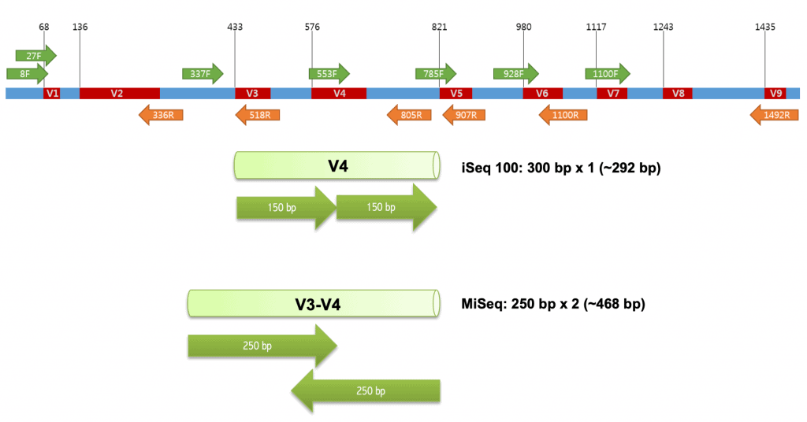
Nrf2 KO PEITC Sample Collection and Processing
Mice fecal samples were collected individually at 3 timepoints: baseline (end of equalizing period, or Week 0), an early timepoint (Week 2) and a late timepoint (Week 4)
Samples were frozen in liquid nitrogen and stored in -80’ freezer
Bacterial DNA were extracted using PowerSoil DNA Isolation Kit (QIAGEN).
PCR amplification of 16S rRNA was carried using a primer specific for V4 region of the gene.
Index amplicons were pooled and sequenced on MiSeq (Illumina) yielding at least 8,000 300 base pair (bp) pair-ended reads.
https://help.ezbiocloud.net/16s-rrna-and-16s-rrna-gene/

Slide 15
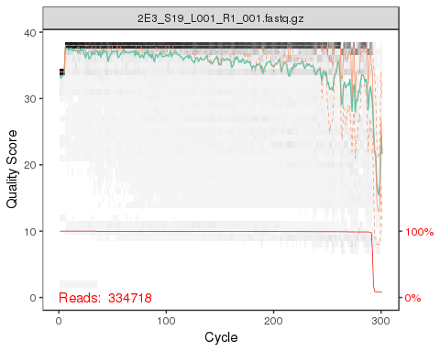
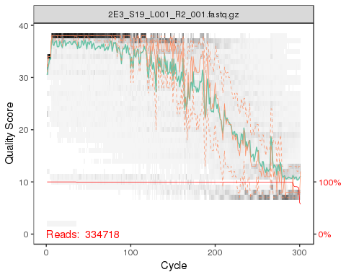
Nrf2 KO PEITC Data Processing: FastQ Files
Single sample from May 2019 experiment
Forward
DADA2 (Divisive Amplicon Denoising Algorithm Version 2) R package was used to process the data
Sequencing machine outputs FastQ format files contain 4 lines of text:
Line 1: @ followed by a sequence identifier and optional description
Line 2: raw sequence letters (A, T, C & G)
Line 3: + followed by same as in Line 1
Line 4: quality scores corresponding to Line 2. The score is a function of p that the base was identified incorrectly such that Qsanger=-10*Log10(p)
Reverse

Slide 16
Nrf2 KO PEITC Data Processing with DADA2
Kingdom | Number of OTUs in Nrf2 KO Mice | Number of OTUs in WT Mice | Percent of OTUs in Nrf2 KO Mice | Percent of OTUs in WT Mice
Bacteria | 10,197 | 7,994 | 94.78% | 98.34%
Eukaryota | 472 | 116 | 4.39% | 1.43%
Unknown | 86 | 19 | 0.80% | 0.23%
Archaea | 4 | 0 | 0.04% | 0.00%
FastQ files are then trimmed to remove low quality bases (usually at the end due to accumulation of technical errors)
Reverse reads are typically of a lower quality compared to the forward reads so they are trimmed a little more (to 220 bp and 280 bp respectively).
Next, the reads were sorted, dereplicated, and forward/reverse reads merged. We removed chimeric sequences (normally around 5-7% but there were much higher in our data – 43.2% in May’s samples).
The reads were then aligned with operational taxonomic units (OTU) using Silva V132 rRNA library that contains ribosomal subunit RNA sequences. 16S sequencing usually is not specific enough to map OTUs to species so we stopped at Genus level

Slide 17
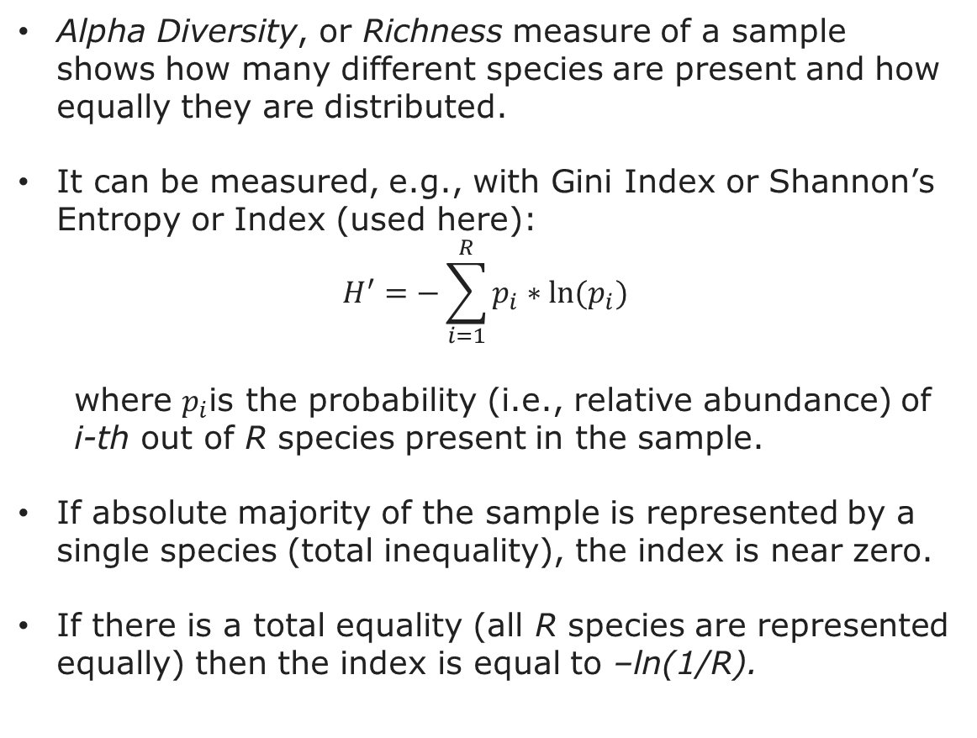
Nrf2 KO PEITC Alpha Diversity
Alpha Diversity, or Richness measure of a sample shows how many different species are present and how equally they are distributed.
It can be measured, e.g., with Gini Index or Shannon’s Entropy or Index (used here):
$$H^{′}=−\sum_{i=1}^{R}{p_{i}∗ln⁡(p_{i})}$$
where $p_{i}$is the probability (i.e., relative abundance) of i-th out of R species present in the sample.
If absolute majority of the sample is represented by a single species (total inequality), the index is near zero.
If there is a total equality (all R species are represented equally) then the index is equal to –ln(1/R).
In our data genotype had a very large effect on alpha diversity, with the KO mice showing higher alpha diversity already at the baseline
Possible confounding with experiment/cage/… effect

Slide 18
Nrf2 KO PEITC Average Alpha Diversity
Mixed-effects linear regression model was used to test the differences in average Shanon’s index by genotype and time (with interactions)
No significant time trend was observed (p-value = 0.290).
Nrf2 KO group had statistically significantly higher alpha diversity compared to the WT (p-value = 0.011).
The Diet*Timepoint interaction was also non-significant (p-value = 0.115)

Slide 19
Bacteroidetes vs. Firmicutes Ratio
On Phylum level, Bacteroidetes vs. Firmicutes ratio (B/F) can be used as an inflammation predictor in guts
Increase of B/F ratio is associated with IBD (NOTE: the ratio is reversed on the graph)
Source: The Influence of Probiotics on the Firmicutes/Bacteroidetes Ratio in the Treatment of Obesity and Inflammatory Bowel disease. Stojanov et al, Microorganisms, 2020

Slide 20
Nrf2 KO PEITC: Bacteroidetes vs. Firmicutes
At the Phylum level, the ratio of Bacteroidetes vs. Firmicutes can affect the homeostasis in the guts
These two phyla combined accounted for over ¾ of all OTUs
B/F was significantly higher than 1 (i.e., higher abundance of Bacteroidetes compared to Firmicutes) at all 3 timepoints in Nrf2 KO, and at the baseline only in the WT (1.63, 95% C.I. = 1.31 to 2.04, p-value < 0.001).
Diet did not make a difference (p-value = 0.992)

Slide 21
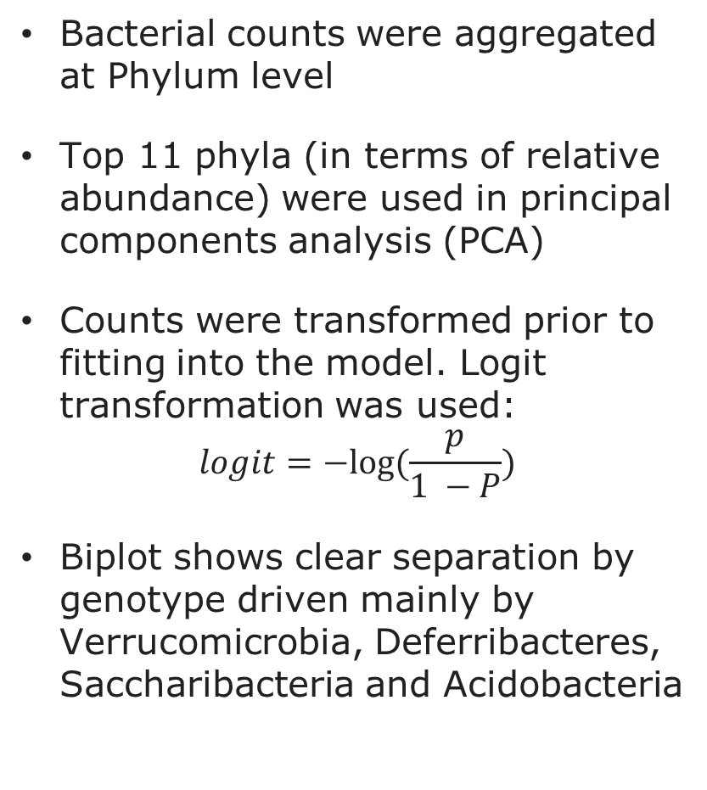
Nrf2 KO PEITC: PCA on Phylum Level
Bacterial counts were aggregated at Phylum level
Top 11 phyla (in terms of relative abundance) were used in principal components analysis (PCA)
Counts were transformed prior to fitting into the model. Logit transformation was used:
$$logit=−log⁡(\frac{p}{1 −P})$$
Biplot shows clear separation by genotype driven mainly by Verrucomicrobia, Deferribacteres, Saccharibacteria and Acidobacteria

Slide 22
3. PEITC and Cranberry diet in DSS-treated WT and Nrf2 KO Mice

Slide 23
DSS-Induced IBD Study Design
C57BL/6J wild-type (WT) mice were purchased from Jackson Laboratory
C57BL/6J Nrf2 knock-out (Nrf KO) mice have been maintained in our laboratory since 2005
Mice were firstly given a 2-week gut microbiota equalization period fed with AIN-93M control diet
Mice were given dextran sodium sulfate (DSS) to induce IBD
4 treatment groups: Naïve, DSS, DSS+Cranberry and DSS+PEITC
3 mice in each treatment*genotype group
Treatment | Genotype
 | Nrf2 KO | WT
DSS | 3 | 3
DSS+Cranberry | 3 | 3
DSS+PEITC | 3 | 3
Naive | 3 | 3

Slide 24
Data Processing
FastQ files were processed as before using DADA2 workflow
Sequencing depth ranged from just over 25K to almost 100K
Majority of OTUs were identified as bacterial (> 96%); the rest were removed from the analysis
Kingdom | Number of OTUs | Percent of OTUs
Bacteria | 7,558 | 96.07%
Eukaryota | 232 | 2.95%
Unknown | 75 | 0.95%
Archaea | 2 | 0.03%

Slide 25
Alpha Diversity
Alpha Diversity was measured with Shannon’s Index as before
Again, Nrf2 KO mice had higher alpha diversity
Additionally, we checked if Shannon’s index depends on sequencing depth. We found no relationship between the two.

Slide 26
Average Alpha Diversity
Mixed-effects linear regression model was used to test the differences in average Shanon’s index by genotype, diet and time (Baseline vs. Week 8, with interactions)
No significant time trend was observed (p-value = 0.868).
Cranberry diet resulted in significantly lower alpha diversity compared to the negative control (DSS) (p-value = 0.017)
Nrf2 KO group had significantly higher alpha diversity compared to the WT (p-value < 0.001).
Additionally, the index increase from baseline to Week 8 (delta)was significantly larger in the WT compared to delta in Nrf2 KO

Slide 27
Bacteroidetes vs. Firmicutes
Bacteroidetes/Firmicutes ratio was higher in WT compare to Nrf2 KO groups
In WT, Naïve and DSS+PEITC groups had significantly lower B/F ratio compared to DSS (p-values < 0.001), but this was not observed in the Nrf2 KO groups.
Surprisingly, these findings did not match the results from the 2 previous experiments in terms of higher B/F in Nrf2 KO groups but trends over time were similar

Slide 28
PCA on Phylum Level
OTUs that were not mapped to a known phylum were removed
Bacterial counts were aggregated by 12 phyla but only a single sample contained 9 OTUs of Chlamydiae so the phylum was removed from the analysis
Cyanobacteria OTUs were removed: possibly came from food

Slide 29
PCA on Phylum Level Labeled by Treatment
Separation by treatment is a lot less clear
Naïve group can be mostly separated from the 3 DSS groups but some DSS samples are intermixed with it

Slide 30
Microbial Metabolites
The following microbial metabolites were measured in samples at week 2 (early samples) and Week 6 (late samples):
A panel of 20 amino acids
A panel of 12 bile acids
A panel of 8 short chain fatty acids

Slide 31
Microbial Metabolites: Aminoacids
Alanine
Glycine
A panel of 20 aminoacids was measured at 2 timepoints: early (Week 2) and late (week 6)
We could model each aminoacid separately by genotype, treatment and timepoint

Slide 32
Microbial Metabolites: Aminoacids PCA

Slide 33
Microbial Metabolites: Aminoacids PCA Week 6
Most of the PEITC and Cranberry samples showed higher level of metabolites compared to the Naïve and DSS groups that received a regular diet
Cranberry diet produced most of the extreme values.

Slide 34
Microbial Metabolites: Aminoacids PCA Week 6
With some exceptions, WT mice produced more aminoacids compared to Nrf2 KO mice
The effect of genotype is more dramatic than the effect of PEITC or cranberry treatments

Slide 35
Compositional Omics Model-Based Integration (COMBI)
Combines latent variable modelling and log-ratio link functions with mean-variance modeling
COMBI model is embedded in a regression framework
Allows to combine several types of data (e.g., OTU table with metabolites) and visualize it using triplot

Slide 36
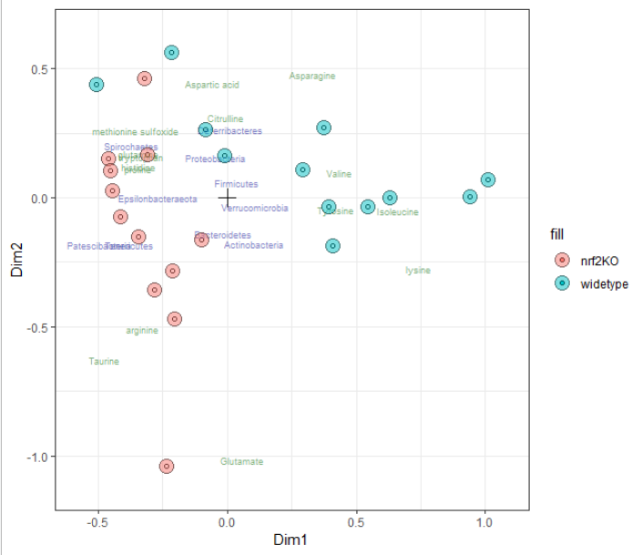
COMBI: Late Timepoint Phlylum + Aminoacids by Genotype
Clear separation of Nrf2 KO and WT samples
Blue labels show bacteria phyla in relationship to the center (cross)
Green labels show aminoacids in relation to the center

Slide 37
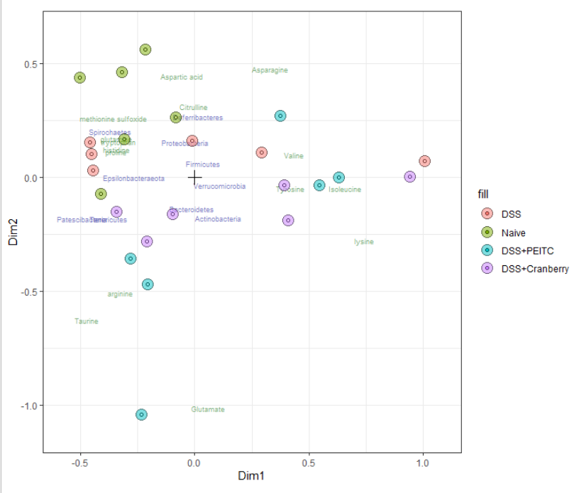
COMBI: Late Timepoint Phlylum + Aminoacids by Treatment
Good separation between regular and PEITC/Cranberry diets
Blue labels show bacteria phyla in relationship to the center (cross)
Green labels show aminoacids in relation to the center

Slide 38
Conclusion: Usefulness of the exploratory analysis
Microbial profile can be used as a diagnostic tool for IBD, UC and Crohn’s disease
It can also be useful for genotype profiling
Microbiome composition helps with understanding of production of metabolites give specific diet
Some communal bacterial species can be isolated and used as a treatment for dysbiosis and can help restore homeostasis in host’s guts by interacting with host’s immune system (e.g., Treg cell activation).

Slide 39
Lessons Learned and Future Work
Importance of baseline correction: germ-free mice, antibiotic/high fiber pretreatment followed by fecal transplant or probiotic treatment
Collecting enough samples to extract both, bacterial counts and metabolites from same samples
In inflammation models, exploring inflammation markers: inflamed guts, immune cells and cytokines in the tissue, etc.
We need to understand functionality of specific bacterial species and the mechanisms of interaction between bacteria and host’s cells via bacterial metabolites

Slide 40
Acknowledgment
Dr. Kong’s Lab, Rutgers
Ran Yin
Rasika Hudlikar
Renyi Wu
Shanyi Li
Hsiao-Chen Kuo
Dr. Ah-Ng Kong
Dr. Blaser’s Lab, Rutgers
Zhan Gao
Dr. Martin J. Blaser
Ghent University, Belgium
Stijn Hawinkel
Olivier Thas
University of Hasselt / Janssen PRD
Luc Bijnens

Slide 41
Q&A

Slide 42
Backup: Ensemble Learning and Random Forest

Slide 43
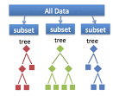
What is Ensemble Learning?
Methods such as decision trees (regression and classification) are easy to communicate the statistical results to non-statisticians
However, they are very unstable. E.g. subsets of same data may produce very different trees
Ideal approach: use multiple data sets (population samples) to build models, and aggregate the results
In reality, often it is a single dataset
Solution: resampling to generate multiple subset of the data and use them to build the models
Plausible approaches: Bagging, Random Forest, Boosting and Stacking (model averaging is not covered here)
https://towardsdatascience.com

Slide 44
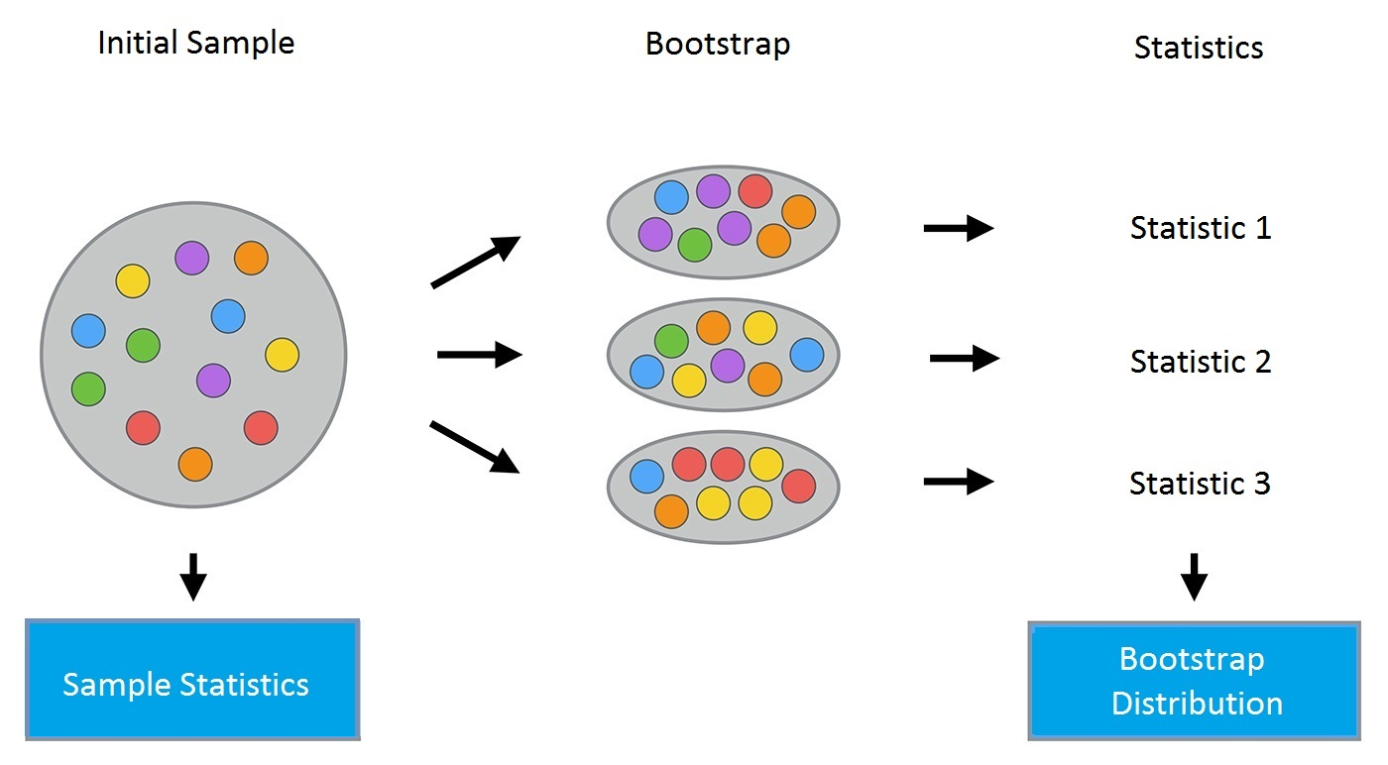
Ensemble Learning Steps
Step 1: Build a population of training sets from the original data (e.g. bootstrap)
Step 2: Apply simple models (learners) to the training data. The output of each model can be predicted values, variables selected, proportion
Step 3: Combine the results, e.g.:
Average value of the predicted value (regression models)
Proportion of being assigned to a certain class or average minimum depth of each variable (classification trees)
Number of times selected by a model (regularization techniques)
https://www.kaggle.com/kashnitsky/topic-5-ensembles-part-1-bagging

Slide 45
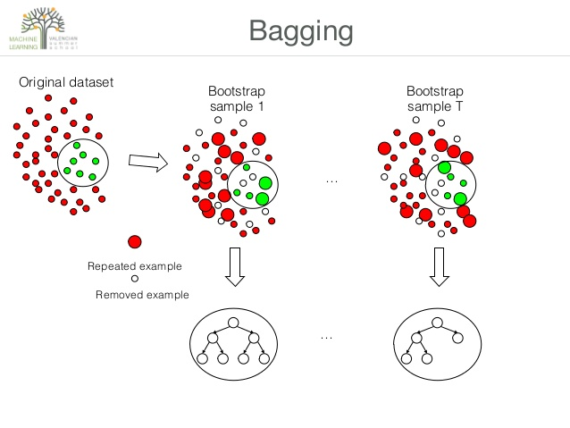
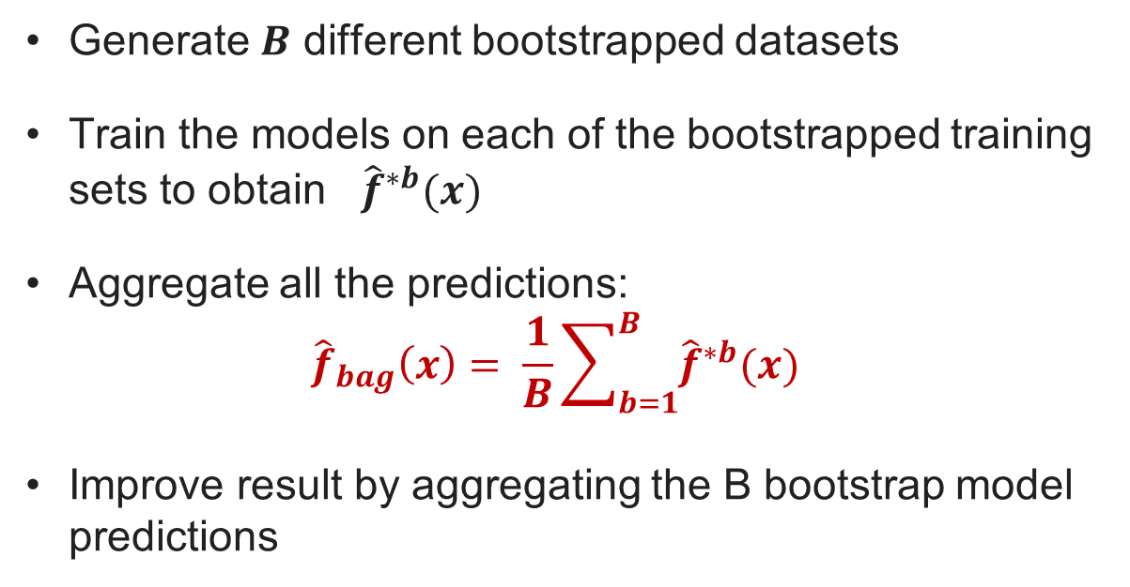
The Idea of Bootstrap Aggregating (aka Bagging) Bagging Only Ensemble (BagE)
Generate $B$ different bootstrapped datasets
Train the models on each of the bootstrapped training sets to obtain ${\hat{f}}^{∗b}(x)$
Aggregate all the predictions:
$${\hat{f}}_{bag}\left(x\right)= \frac{1}{B}\sum_{b=1}^{B}{{\hat{f}}^{∗b}(x) }$$
Improve result by aggregating the B bootstrap model predictions
Image source: https://www.slideshare.net/mlvlc/l4-ensembles-of-decision-trrees

Slide 46
Using BagE on Microbiome Data
Administer a cocktail of 20 bacterial species (spec1 through 20) to 50 ulcerative colitis (UC) patients
Not all species will become grafted
Record presence/absence of each species in patients’ stool samples
Response: reduction/absence of inflammation after the treatment (23 patients still had inflammation/27 did not)
Use bagging (BagE): create 10 bootstrap samples
Construct classification trees
If a node reaches a prespecified criteria (contains less than 5 observations, most responses are the same, etc.) – stop (the node becomes a leaf)
18/32*
0/3
spec6
no
yes
18/29
17/26
spec11
1/3
no
yes
…

Slide 47
BagE: Aggregating Multiple Trees
25/25**
For each of the 10 trees, record the minimum depth at which each species showed up
Average the minimum depth for each species across all 10 trees
Predictions?
Rank the bacterial species according to the average minimum depth
18/2
spec5
7/23
no
yes
30
8/1
spec11
10/1
4/0
spec6
3/23
no
no
Species | Average Min Depth
Spec6 | 1.3
Spec5 | 2.1
… | …
yes
yes
…
…
…
https://cen.acs.org/biological-chemistry/microbiome/gut-might-modify-mind/97/i14

Slide 48
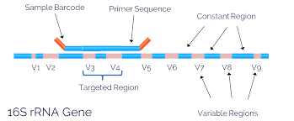
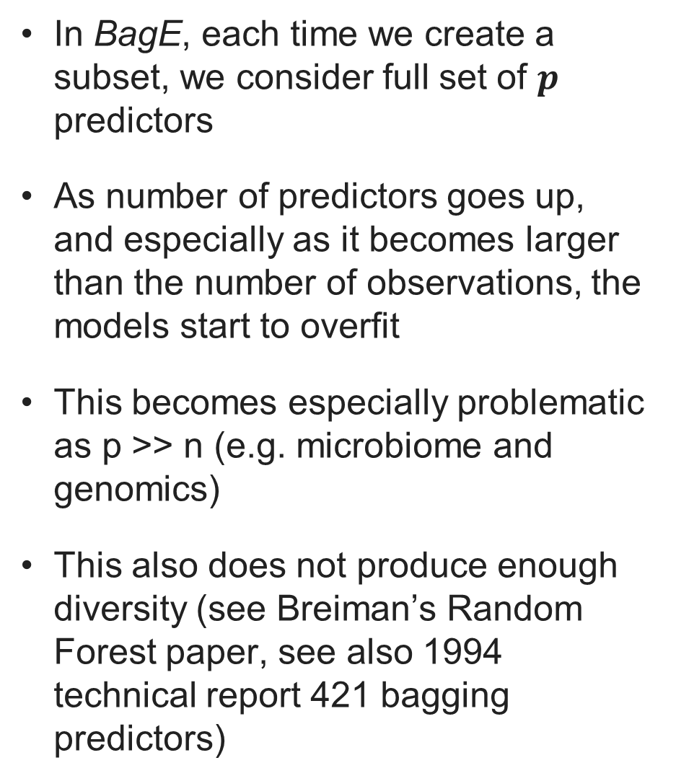
Limitations of BagE
In BagE, each time we create a subset, we consider full set of $p$ predictors
As number of predictors goes up, and especially as it becomes larger than the number of observations, the models start to overfit
This becomes especially problematic as p >> n (e.g. microbiome and genomics)
This also does not produce enough diversity (see Breiman’s Random Forest paper, see also 1994 technical report 421 bagging predictors)
In microbiome analysis, whole bacterial genome sequencing can be done
16S is a popular choice
Hundreds of operational taxonomic units (OTU) are identified
https://www.lcsciences.com/discovery/applications/genomics/16s-mobile/

Slide 49
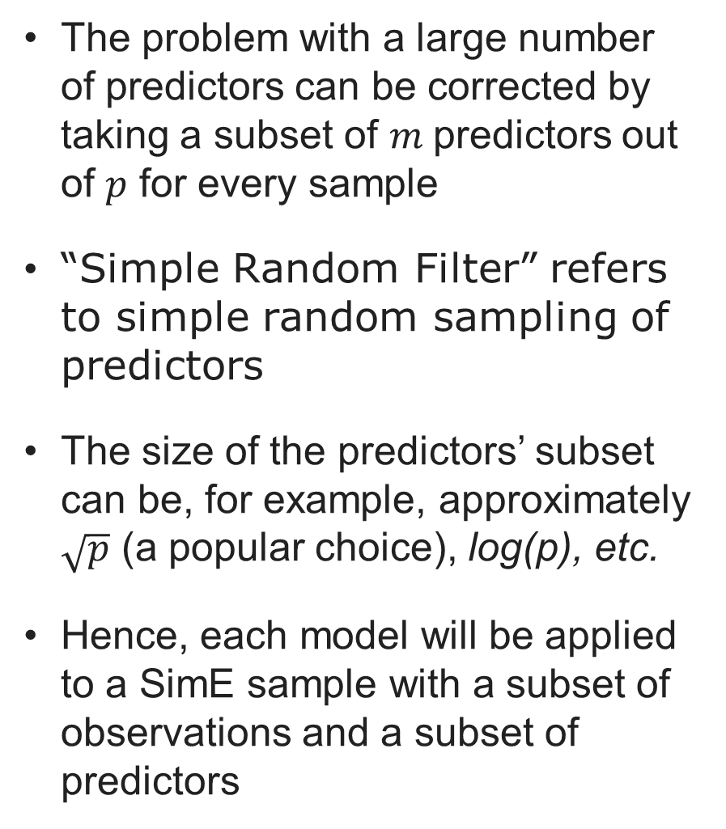
Simple Ensemble with Simple Random Filter (SimE)
Example: OTU table with bacterial counts in n samples for each of the p OTUs
The problem with a large number of predictors can be corrected by taking a subset of $m$predictors out of $p$ for every sample
“Simple Random Filter” refers to simple random sampling of predictors
The size of the predictors’ subset can be, for example, approximately $\sqrt{p}$ (a popular choice), log(p), etc.
Hence, each model will be applied to a SimE sample with a subset of observations and a subset of predictors
Sample | OTU
 | OTU1 | OTU2 | OTU3 | … | OTU(p)
Sample1 | 10 | 13 | 25 | … | 31
Sample2 | 92 | 15 | 12 | … | 22
Sample3 | 33 | 1,390 | 323 | … | 1
… | … | … | … | … | …
Sample(n) | 0 | 0 | 212 | … | 123
Samples’ meta-data and the response to treatment
Sample | Inflammation | Age | Sex | Timepoint
Sample1 | Yes | 36 | Male | Baseline
Sample2 | No | 41 | Female | Week 4

Slide 50
Using SimE for OTU Table Analysis
400 OTUs were identified
Create 10 bootstrap samples:
Logistic regression on each subset
Patient | Log of Delta Relative Abundance
 | OTU1 | OTU2 | OTU3 | … | OTU400
P1 | -1.23 | 0.01 | 0.12 | … | 0.21
P2 | 1.11 | -0.43 | 2.22 | … | 0.13
P3 | 0.21 | 1.11 | -1.02 | … | 1.00
… | … | … | … | … | …
P50 | .00 | 1.44 | -3.21 | … | -2.44
Patient | Log of Delta Relative Abundance
 | OTU1 | OTU2 | OTU3 | … | OTU400
P1 | -1.23 | 0.01 | 0.12 | … | 0.21
P2 | 1.11 | -0.43 | 2.22 | … | 0.13
P3 | 0.21 | 1.11 | -1.02 | … | 1.00
… | … | … | … | … | …
P50 | .00 | 1.44 | -3.21 | … | -2.44

Slide 51
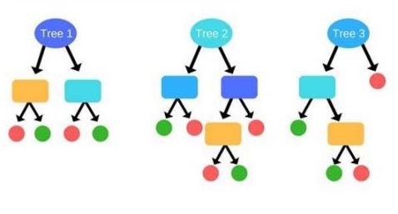
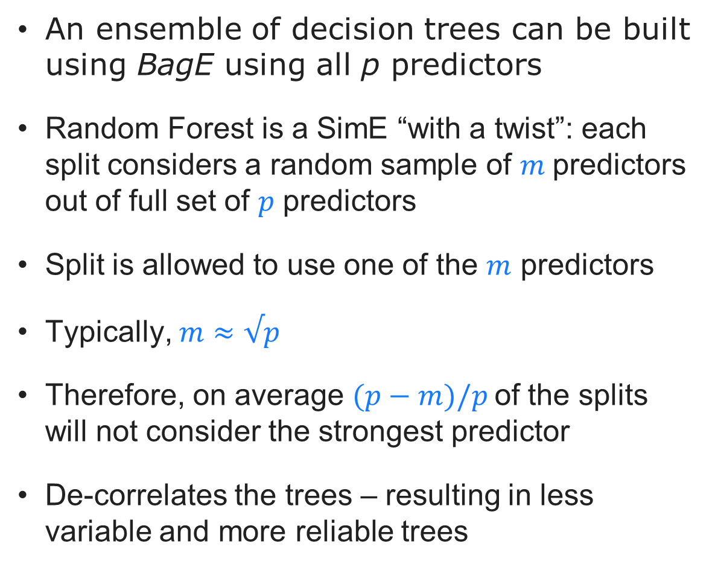
Simple Tree Ensemble vs. Random Forest
An ensemble of decision trees can be built using BagE using all p predictors
Random Forest is a SimE “with a twist”: each split considers a random sample of $m$predictors out of full set of $p$ predictors
Split is allowed to use one of the $m$ predictors
Typically, $m≈√p$
Therefore, on average $(p−m)/p$of the splits will not consider the strongest predictor
De-correlates the trees – resulting in less variable and more reliable trees

